Slide 1

Lecture 9.1
Arrays & Objects Drills

Slide 2

Agenda
Arrays Revisions
Array Methods
Functional Array Functions
Objects Revisited

Slide 3
Arrays Revisions

Slide 4


What is array (again)?
Lists/Arrays is simply a list of value or objects
Technically, you could put anything in it (even if each elements are of different types)
Best Practice: You should try to put only same type of values/objects into the same array
// Good Example
// Bad Example

Slide 5
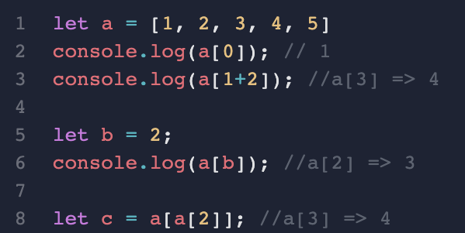
How to access the content in the array?
use array_name[index]
index start from 0
index can also be a variable or a result of calculation

Slide 6
Array Methods

Slide 7
Two Major Types of Array Methods
Traditional Array Methods (Self-Study in Reading Materials)
  Mutating (changing the original array)
  Non-mutating (Not changing the original array)
Functional Array Methods (All non-mutating)

Slide 8
Functional Array Methods

Slide 9
Functional Array Methods
Methods that take a "Function" as input for how to process the array.
Most commonly used methods:
  Array.map() - Creating an new array based on the original array
  Array.filter() - Removing some values

Slide 10
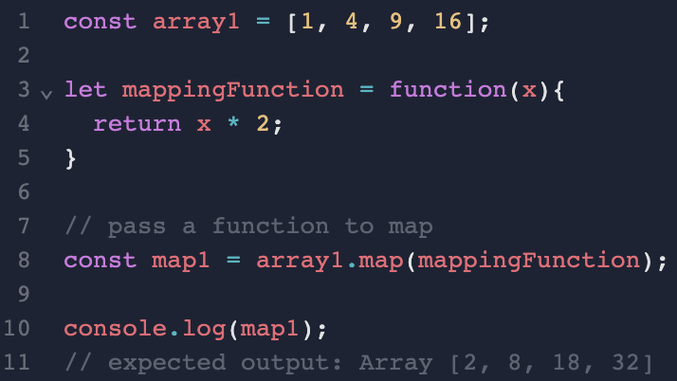
Array.map()

Slide 11
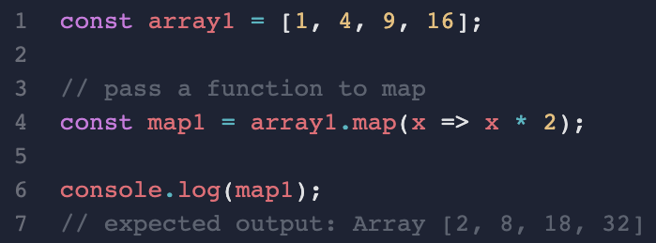
Array.map()

Slide 12
Usage
To convert every elements of an array into another value based on a rule
  convert a list of scores into grades
  convert a list of “cm” values to “m”
Frequently used in data processing and frontend/backend programming

Slide 13
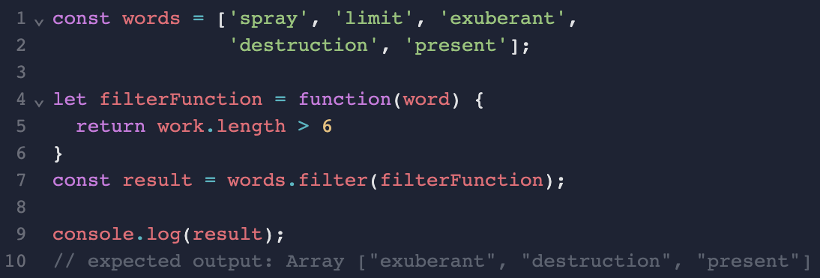
Array.filter()

Slide 14
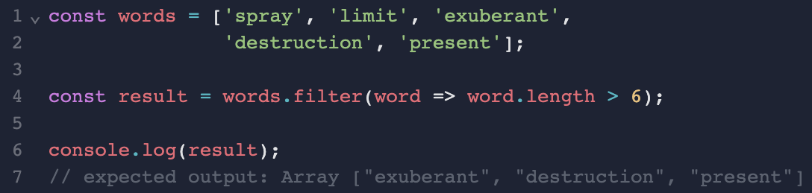
Array.filter()

Slide 15
Usage
To extract the values that fulfil the requirements only
  select a list of students with score higher than a particular score
  select a list of people whose height > 1.8m
Frequently used in data processing and frontend/backend programming

Slide 16
Objects Revisited

Slide 17
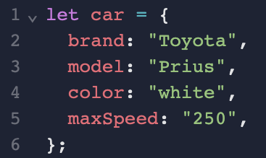
Objects in details
Objects represent a physical concept, e.g. cars, users, houses
Each object should contains a set of properties - the characteristics of the object
// Example

Slide 18
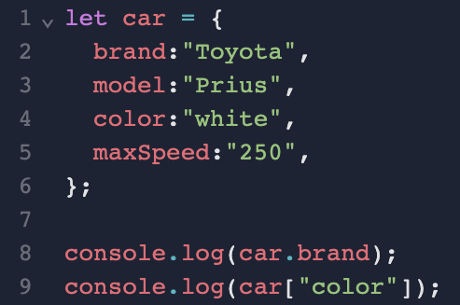
How to access value of an object?
Two ways:
  objectName.propertyName
  objectName["propertyName"]

Slide 19
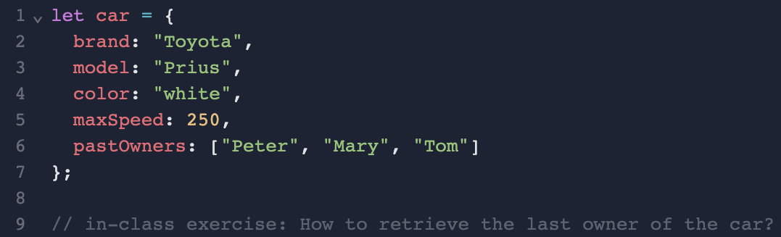
Anything could be a Property in Object
Notes:
// One line answer
car.pastOwners[car.pastOwners.length-1] //Tom

Slide 20
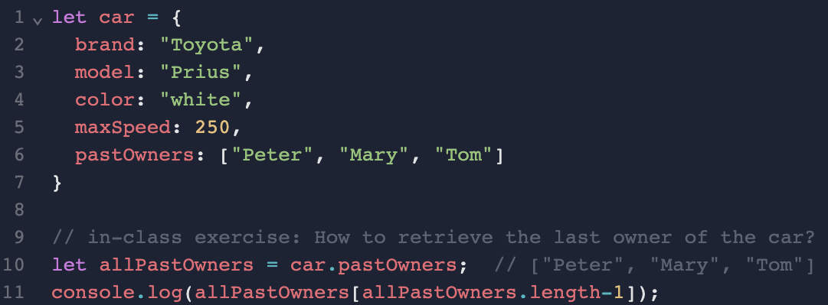
Anything could be a Property in Object

Slide 21
Array of Objects with Array Methods
Please read up and practice with Reading Materials 10.3

